Slide 1

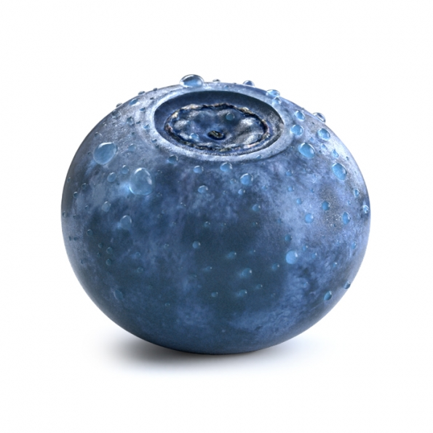
Realism in Computer Graphics
Images by Hervé Steff http://www.insideko.com/. Rendered with Maxwell Render.
If it looks like computer graphics, it is not good computer graphics.
-Jeremy Birn

Slide 2
Realism in Computer Graphics
Goal of many graphics algorithms is to create results that are as physically realistic as possible
Realism in graphics can be subdivided into different categories:
geometric modeling, rendering, behavior, and interaction
Techniques and algorithms used to achieve realism in category are dependent on several factors
application or content (movies, scientific visualization, etc.)
user type (novice vs. expert)
resources (time, money, processing power, etc.)
Degree of realism that can be achieved usually depends on amount of resources
when resources are short, use approximations – hacks

Slide 3
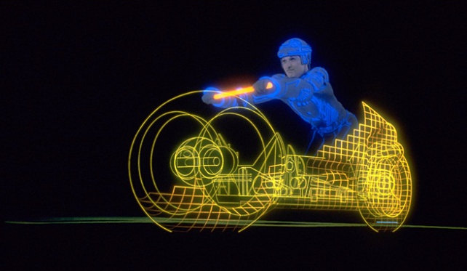
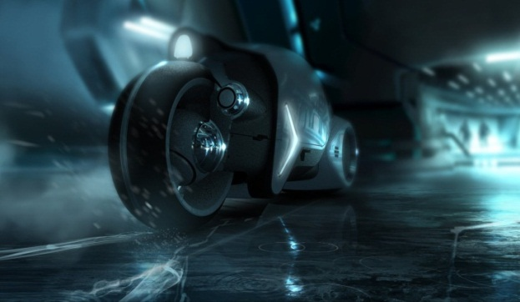
Realism and Media
Tron (1982) vs
Tron Legacy (2010)
Early computer graphics focused on still images
typically meant photorealism – goal was to accurately reconstruct a scene at a specific time
emphasized good approximations of geometry and light reflection properties of surfaces
With the increased production of animated graphics (commercials, movies, special effects, cartoons) comes new standard of realism
character animation
natural phenomena: cloth, fur, hair, skin, grass, trees, smoke, water, clouds, wind
Newtonian physics: objects which collide, fall, scatter, bend, shatter, etc.; articulated figures and mechanisms with joints

Slide 4
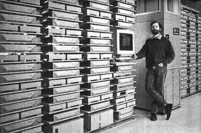
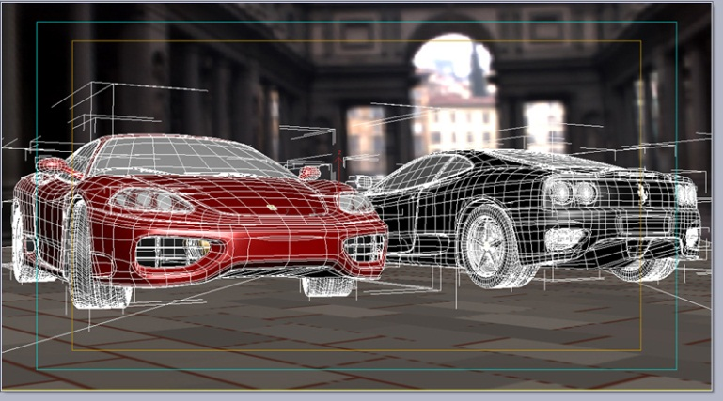
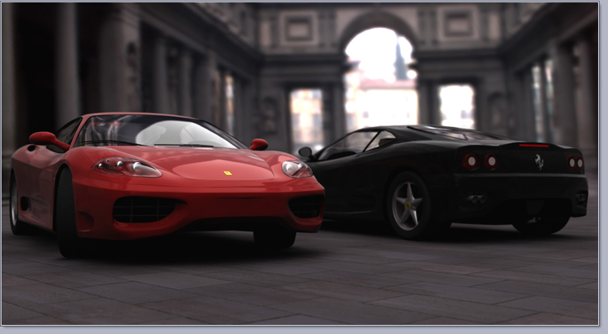
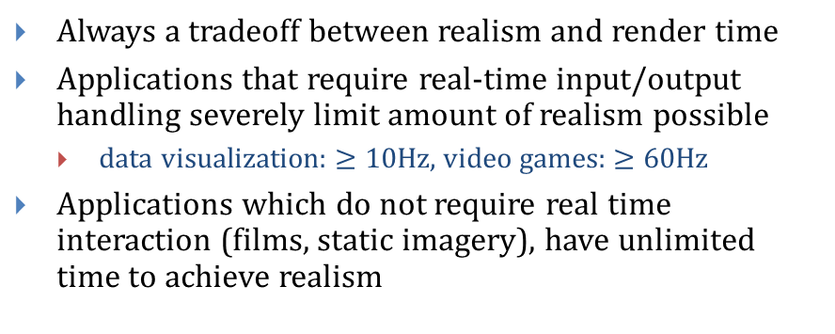
Realism and Media
Always a tradeoff between realism and render time
Applications that require real-time input/output handling severely limit amount of realism possible
data visualization: $≥10$Hz, video games: $≥60$Hz
Applications which do not require real time interaction (films, static imagery), have unlimited time to achieve realism
Pixar Render Farm as used for Toy Story
Real-time Interaction during Modeling (3DS Max)
Rendered Image
Image by Giuseppe Guzzardi, http://www.giuseppeguzzardi.com/

Slide 5
Trade-Offs
When time is limited, optimal balance of techniques for achieving realism in each category (rendering, geometry, interaction, and behavior) depends on the context of use
medium, user, content, and resources (especially hardware)
Medium
Different media may have different needs
For example, a doctor examining x-ray transparencies:
if looking at static transparencies, resolution and rendering accuracy are most important
if browsing through a large data set of x-rays (zooming, panning), may want to sacrifice render quality for interaction
User
Expert or novice user?
For example, user looking at a weather map
novice may not care about the fine detail
expert will want all the fine detail (fluctuations, patterns)
What does the user care about most?

Slide 6
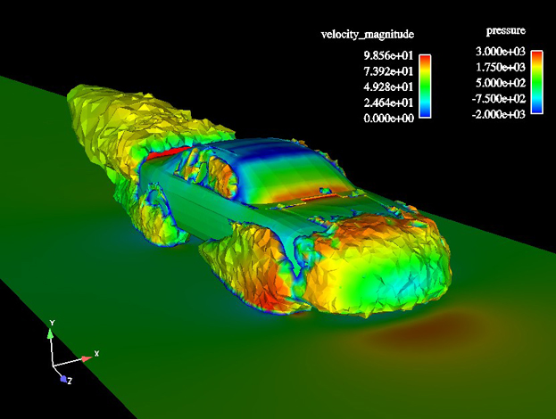

Trade-Offs
Content
consider a movie vs. scientific visualizations and CAD models
movie will want to achieve as many special effects as possible (motion blur, depth of field, etc.)
CAD (engineering) models will skip these special effects for clarity
scientific visualizations will display the geometric model and/or simulation data as is, without any approximations, curve smoothing, etc. , to avoid hiding artifacts, approximations, or errors

Slide 7

Trade-Offs
Resources
Graphics processing power is constantly changing (real time ray tracing is now possible on the GPU)
Processing power vs. amount of data
cube can be realistically rendered in real time with any modern hardware
100M triangle model like Lucy, pictured at left, not yet
Stanford Lucy model contains 19,027,872 vertices, 28,055,742 triangles – about 508 MB
Rendered using V-Ray (Chaos Group)
Many techniques developed to achieve realism in each category
Geometry, Rendering, Behavior, and Interaction
Rendered by Chaos Group (V-Ray)

Slide 8
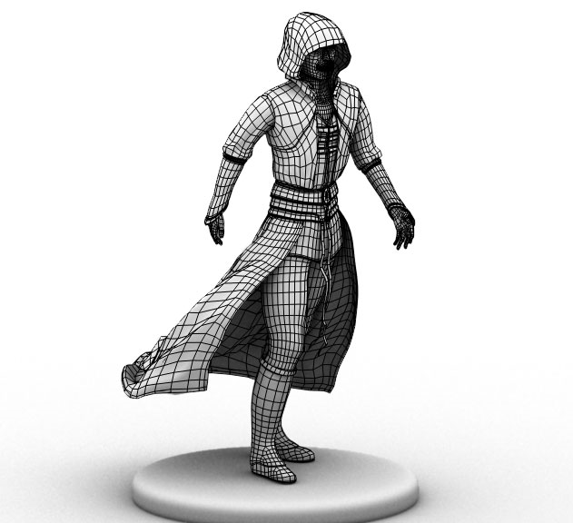
Realism in Geometry (1/8)
Polygonization
represent objects as sets of polygons (ex. triangles, quads)
can be tessellated depending on amount of detail needed
finite level of detail – if we zoom in it doesn’t look good
easily hardware accelerated
often want simplest mesh possible while preserving as much detail as possible
fewer vertices needed at flat, simple portions of mesh
more vertices needed at complex varying regions of mesh

Slide 9
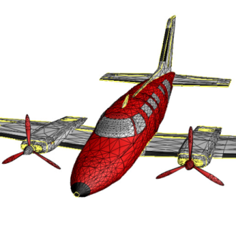
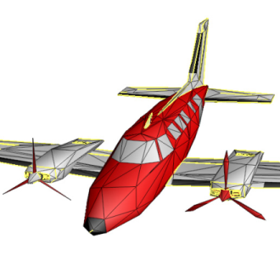
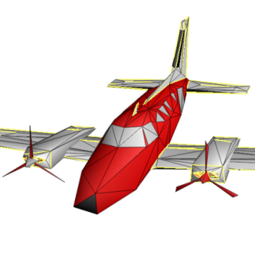
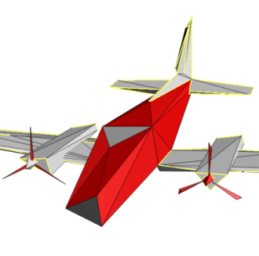
Realism in Geometry (2/8)
Mesh simplification / decimation
take detailed model, reduce number of polygons while keeping as much shape as possible
which vertices to remove?
various algorithms exist – active area of research
Meshes can also be smoothed, sharpened, manipulated, etc.
same concepts learned in Filter can be applied to 3d models instead of 2d images
ex. smoothing a mesh requires removing high frequencies

Slide 10
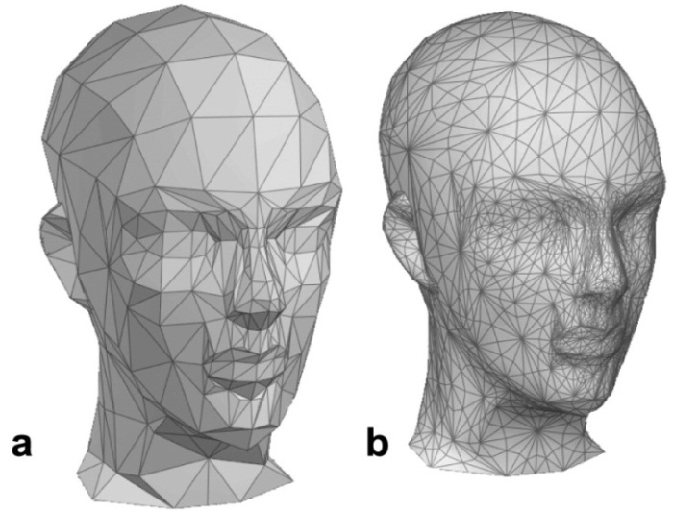
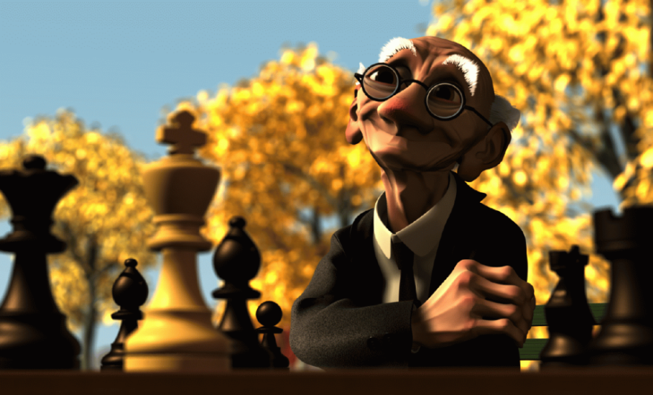
Realism in Geometry (3/8)
Subdivision Surfaces
two step process to add more detail to mesh:
refinement (add new vertices)
smoothing
several schemes for subdividing
Ex: Loop subdivision - subdivide each triangle into four new triangles
continuously subdivide triangles into more triangles for more detail as needed
low polygon models can appear smooth
allows for editing of multi resolution models (editing at various levels of detail)
Geri was modeled using subdivision surfaces

Slide 11
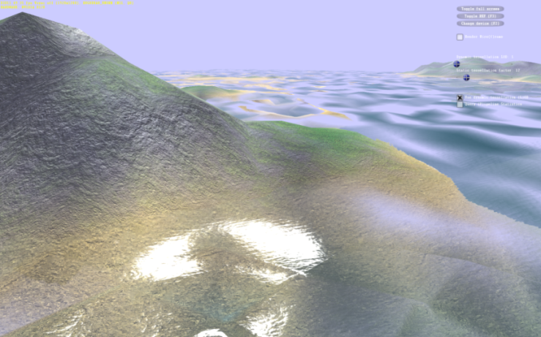
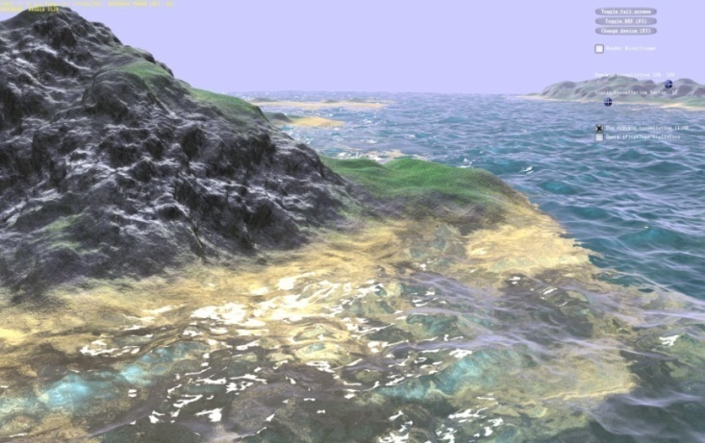
Realism in Geometry (4/8)
Dynamic LOD
objects far from the camera don’t need as many polygons, while objects closer should have more
replace farther objects with low res meshes
causes discontinuous jumps “popping” as meshes are replaced
multiple versions of model in scene graph (differing only in level of detail)
Hardware tessellation
DirectX 11 and OpenGL 4.0 introduced full support for procedural hardware tessellation
allows for seamless LOD – tessellation can be modified on the fly
hull shader determines how many times to subdivide (for example, as a function of the size of the patch in pixels on the display)
no longer necessary to store multiple versions of model
Terrain and water rendered at different LODs

Slide 12

Realism in Geometry
DirectX 11 Unigine Heaven Tessellation Demo

Slide 13
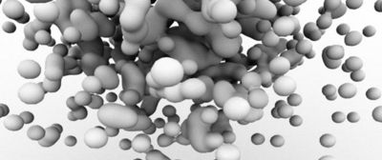
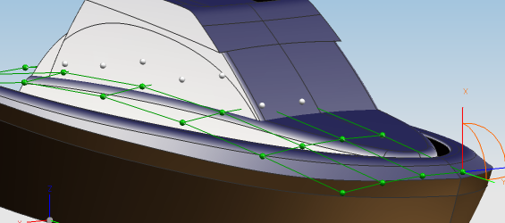
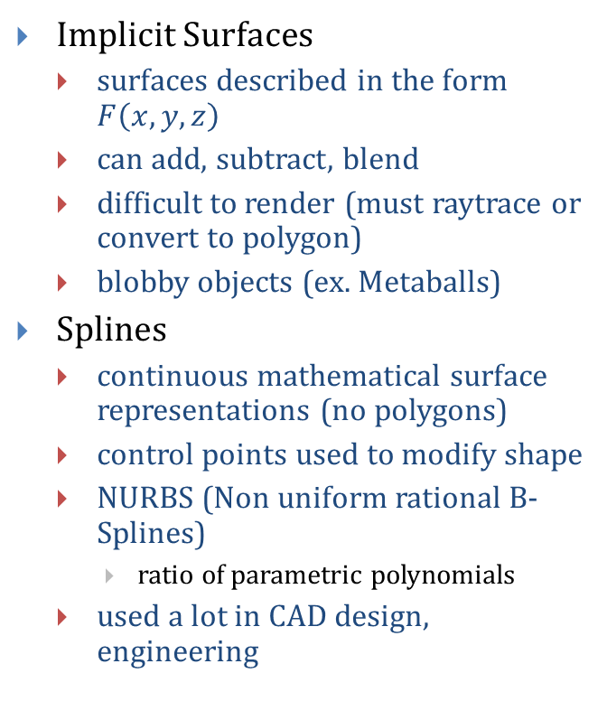
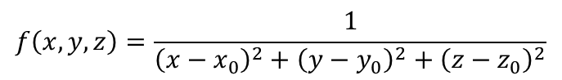
Realism in Geometry (5/8)
Implicit Surfaces
surfaces described in the form $F\left(x,y,z\right)$
can add, subtract, blend
difficult to render (must raytrace or convert to polygon)
blobby objects (ex. Metaballs)
Splines
continuous mathematical surface representations (no polygons)
control points used to modify shape
NURBS (Non uniform rational B-Splines)
ratio of parametric polynomials
used a lot in CAD design, engineering
$$f\left(x,y,z\right)=\frac{1}{{\left(x−x_{0}\right)}^{2}+{\left(y−y_{0}\right)}^{2}+{\left(z−z_{0}\right)}^{2}}$$
NURBS used to model a ship – user moves green control points to modify surface

Slide 14
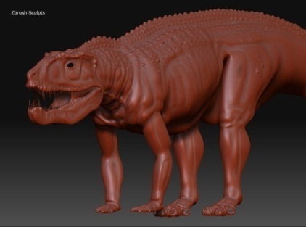
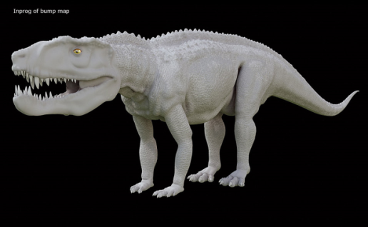
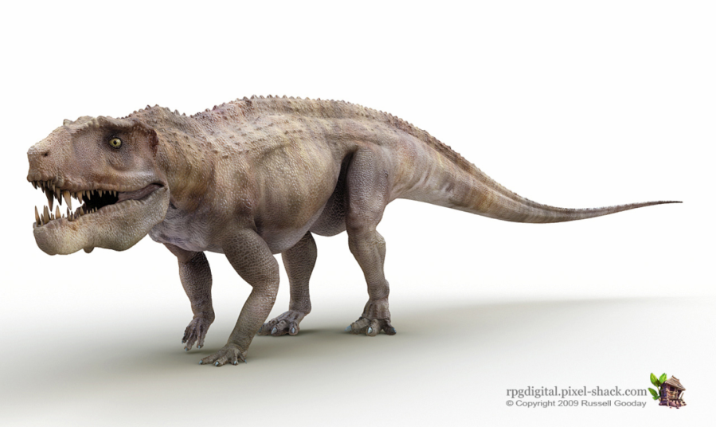
Realism in Geometry (6/8)
Modeled in Zbrush, with bump and texture maps applied. By Mark Bode (http://rpgdigital.pixel-shack.com/)
Texture mapping
map image onto surface geometry to create appearance of fine detail
widely used in movies and games, extremely cheap for the amount of extra detail
Bump mapping
fake surface normals by perturbing them using a 2d height map
creates the appearance of bumps when calculating lighting
Original model
Bump mapped
Texture mapped and bump mapped

Slide 15
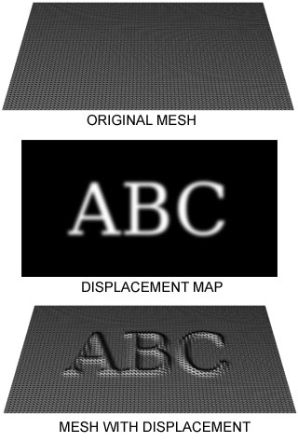
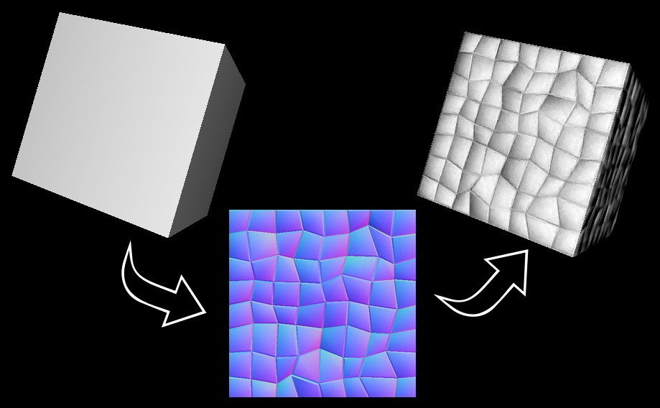
Realism in Geometry (7/8)
Displacement mapping
displace vertices in a mesh by values stored in a 2D texture
actually modifies the geometry
Normal mapping
preferred method of bump mapping on modern GPUs – encodes normals as RGB triplet on a texture
normals are then transferred to the object to give a more detailed look
does not modify the geometry
2D texture

Slide 16
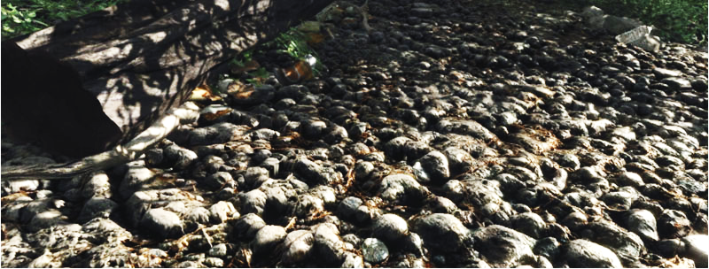
Realism in Geometry (8/8)
Parallax occlusion mapping encodes 3D data into a texture
when the surface is rendered modify the geometry to correspond with data in texture
displaces texture coordinates as a function of view angle to create depth
improvement over regular bump mapping and normal mapping

Slide 17
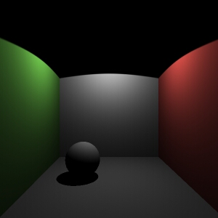
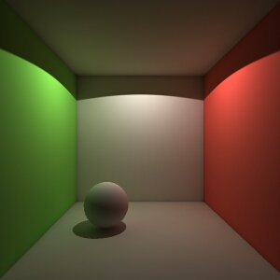
Realism in Rendering (1/19)
Multiple light bounces
add more lighting to the scene by calculating lighting coming directly from light sources, as well as light reflected off of other objects
appears more photorealistic, but much more expensive to compute
Often “hacked” by using a constant ambient term instead
still missing out on color bleeding, diffuse bounces, and other subtle effects
Left: single ray cast via non-recursive ray tracing (3 sec. render time)
Right: multiple light bounces via photon mapping (57 sec.)
Notice the color bleeding caused by light being reflected off of the walls – more realistic

Slide 18
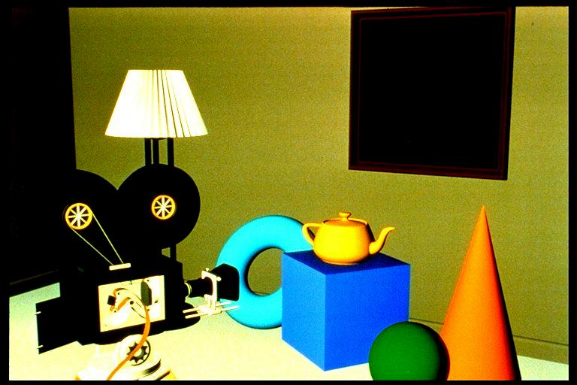
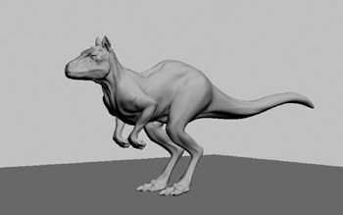
Realism in Rendering (2/19)
Polygonal rendering and Gouraud shading
fast, easily implemented in hardware (default lighting in OpenGL and WPF)
per vertex lighting interpolates color between vertices
lighting is only calculated at vertices from direct light sources
no global illumination
does not look very realistic (hard shadows, no light reflecting off other objects)
Notes:
Picture on the left is a Pixar Shutterbug example image with Gouraud shading and no specular lighting.

Slide 19

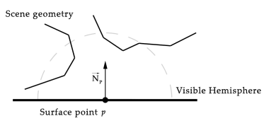
Realism in Rendering (3/19)
Gouraud Shading + Ambient Occlusion = Final Image
Ambient occlusion
hack to approximate GI effects by varying the ambient term (instead of keeping it constant)
vary ambient coefficient depending on visibility of the intersection point
in the diagram, p is partially shadowed because it is occluded by surrounding geometry
looks much better, but still relatively expensive to compute visibility

Slide 20
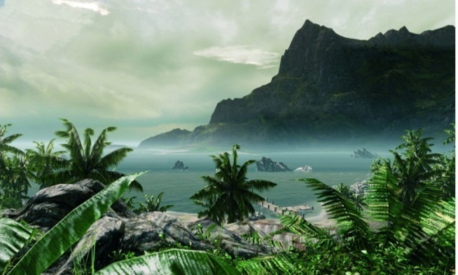
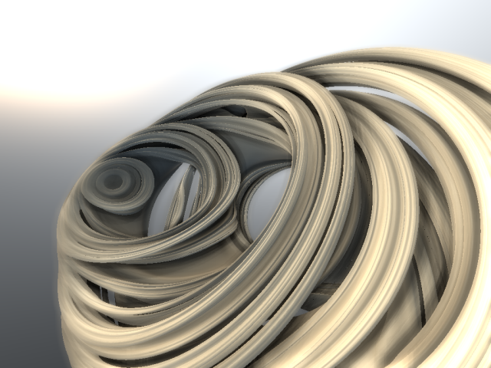
Realism in Rendering (4/19)
Screen Space Ambient Occlusion (SSAO)
approximation to calculating ambient occlusion in real time
uses depth map (from the z-buffer algorithm) to determine lighting
at each rendered pixel, sample the z-buffer and calculate a darkening value based on differences in depth
first used in 2007 game Crysis, developed by Crytek
now used in several modern video games
notice object self shadowing – giving the illusion of global illumination
Cryengine 3, Crytek (SSAO)
Julia Fractal lit in real time using SSAO

Slide 21
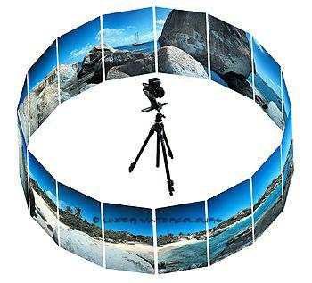
Realism in Rendering (5/19)
Image based rendering (IBR)
more than a decade old
instead of spending time and money modeling every object in a complex scene, take photos
captures both perfectly accurate geometry and lighting with very little overhead
same as 3D image compositing
how to generate views other than the one photo you took? (many correct answers)
highly related to computational photography
QuickTime VR
stitch together multiple photos taken from the same location at different orientations
produces cylindrical or spherical map which allows generation of arbitrarily oriented views from that one position
generating multiple views: discontinuously jump from one precomputed viewpoint to the next
can’t reconstruct missing (obscured) information

Slide 22

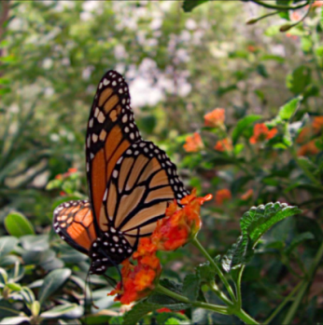
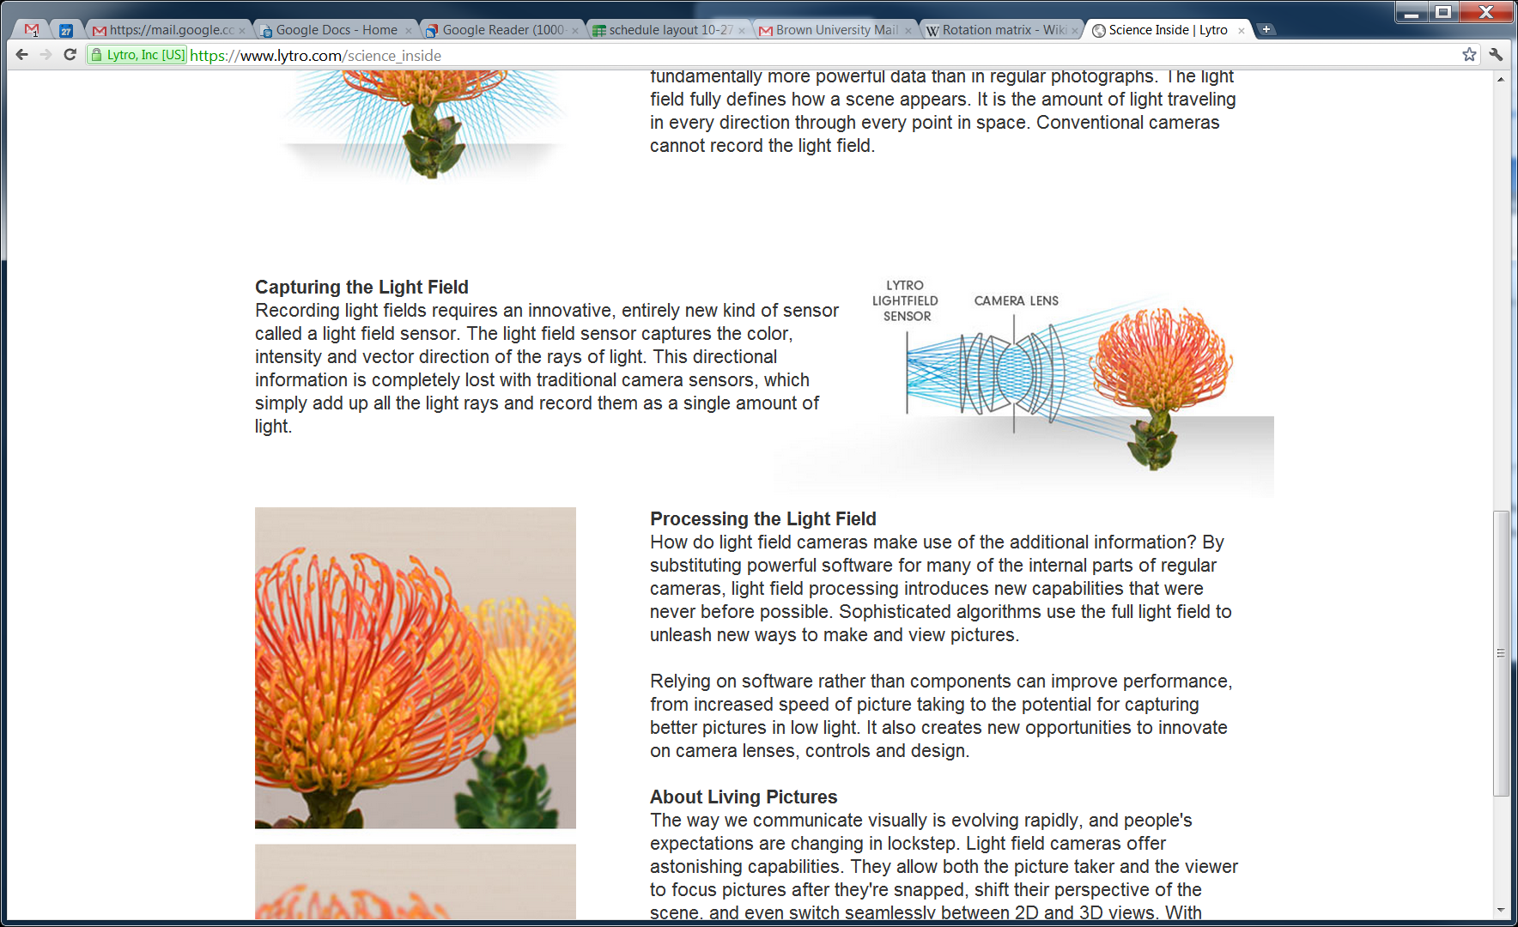

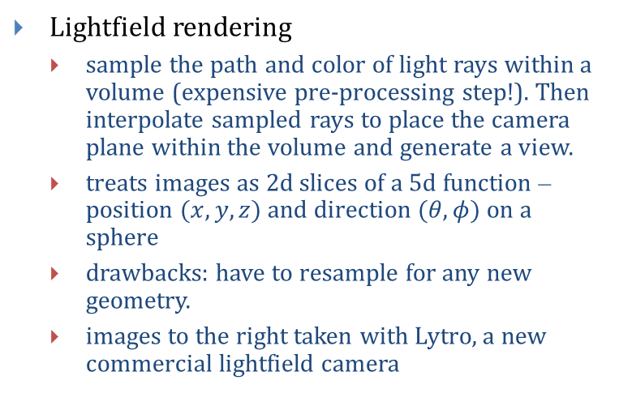
Realism in Rendering (6/19)
Plenoptic modeling
using multiple overlapping photos, calculate depth information from image disparities
combination of depth info and surface color allows on-the-fly reconstruction of “best guess” intermediary views between the original photo-positions.
Lightfield rendering
sample the path and color of light rays within a volume (expensive pre-processing step!). Then interpolate sampled rays to place the camera plane within the volume and generate a view.
treats images as 2d slices of a 5d function – position $(x,y,z)$ and direction $(θ,φ)$ on a sphere
drawbacks: have to resample for any new geometry.
images to the right taken with Lytro, a new commercial lightfield camera
http://www.lytro.com/living-pictures/282
Notes:
Interactive resampling @ link.

Slide 23
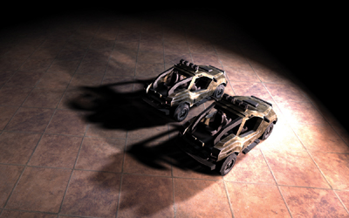
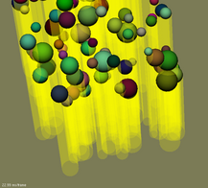
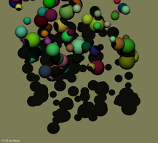
Realism in Rendering (7/19)
Shadow mapping
generate shadow texture by capturing silhouettes of objects as seen from light
project shadow texture onto scene when rendering
fast, but the shadow map must be recalculated for moving lights
Shadow volumes
project rays through each vertex in an object from the light
projected rays will together form a volume
any point inside the volume is in shadow
often implemented using the stencil buffer
Summed area variance shadow maps (GPU Gems 3)
Stencil shadow volumes

Slide 24
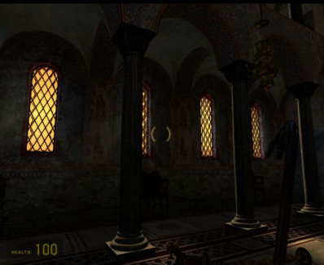
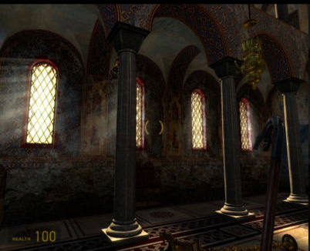
Realism in Rendering (8/19)
Scene rendered without and with HDR
High Dynamic Range (HDR) and Tone Mapping
lighting calculations can exceed 0.0 to 1.0 limit
allows more accurate reflection and refraction calculations
Ex: Sun might have a value of 6,000 instead of 1.0
clamped to 1.0 at render time
Solution: “remap” the colors of the final image to incorporate more of this range

Slide 25

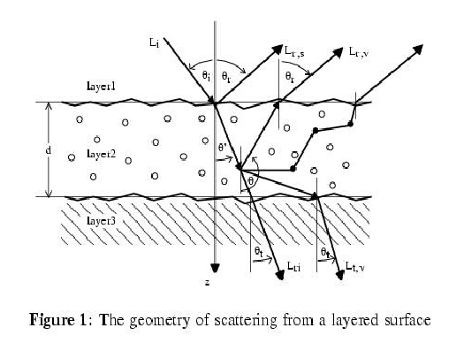
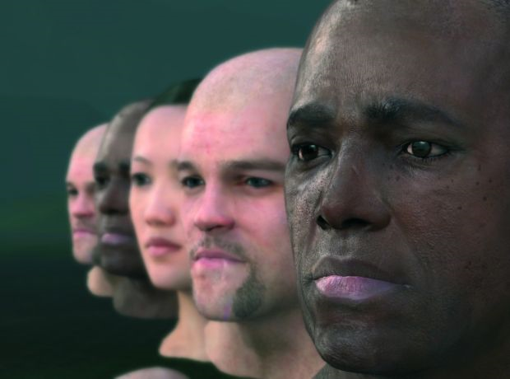
Realism in Rendering (9/19)
Light scattering
light may be scattered as it travels through the atmosphere (participating media) or as it travels under a surface such as wax or skin (subsurface scatter)
expensive to compute
Subsurface scattering
light enters material, bounces around, some exits with new properties
hold your hand up to a light, you’ll notice a “reddish” glow
Subsurface scattering (Pixar Ratatouille)

Slide 26
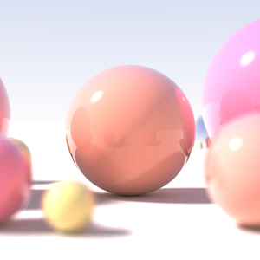
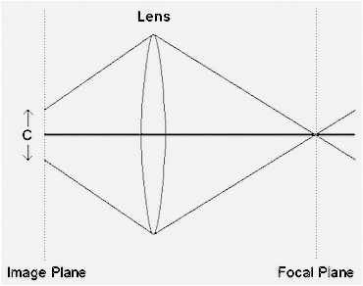
Realism in Rendering (10/19)
Depth of field (DoF)
mimic out of focus effects from real camera (not pinhole camera model)
objects with a certain depth remain in focus, others are blurred
circle of confusion: light from a single point is focused through the lens onto a circle
real-time hack: blur image based on depth and composite final image

Slide 27
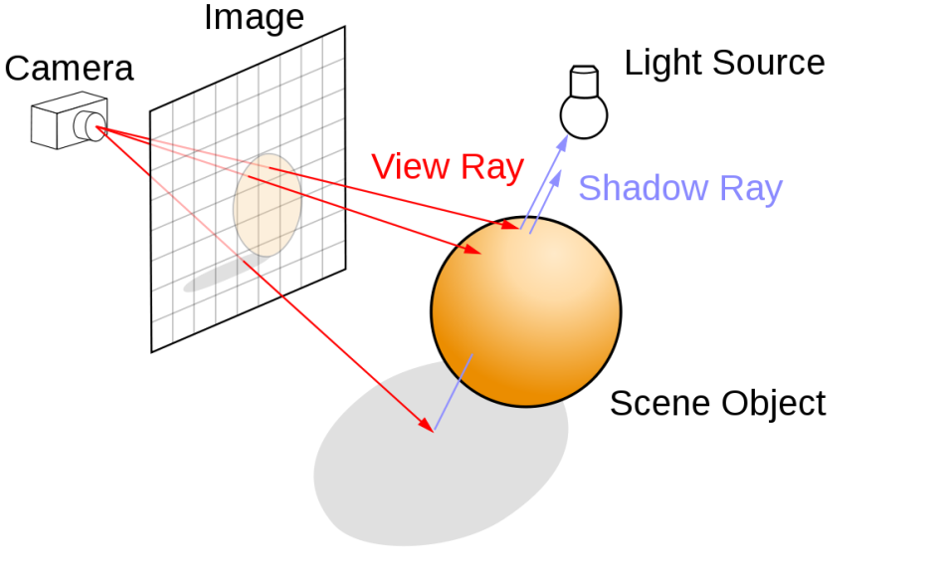
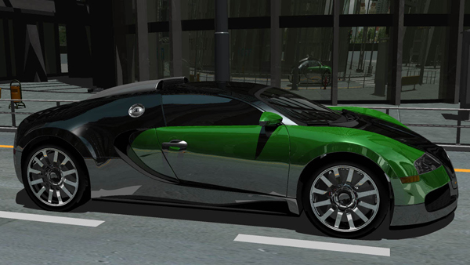
Realism in Rendering (11/19)
Raytracing
shoot rays from the eye into the scene
at each intersection calculate amount of light hitting the object
if the surface is reflective or refractive, reflect /refract the ray and continue tracing
good for shiny, reflective surfaces
can produce caustics:
“the envelope of light rays reflected or refracted by a curved surface or object, or the projection of that envelope of rays on another surface, e.g., the patches of bright light overlaying the shadow of the glass” - Wikipedia
expensive for global illumination
hard to compute multi-bounce lighting
not physically based
nVidia’s real time ray tracer (30fps)

Slide 28
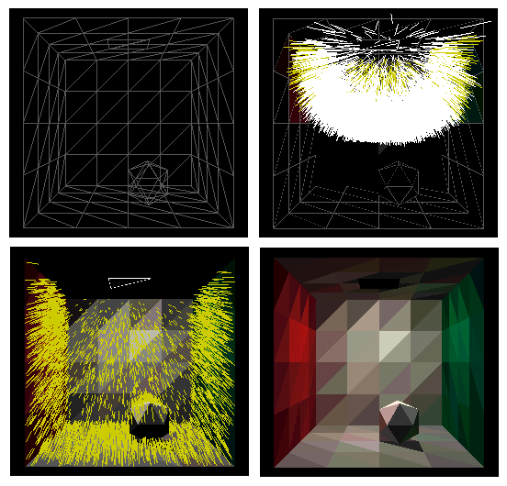

Realism in Rendering (12/19)
Radiosity
subdivide scene into patches, iteratively compute how much light each patch contributes to each other patch
circular problem but get attenuation
some of patch A contributes to patch B, which contributes back to A, which contributes back to B
expensive to solve (iterate through matrices)
good for diffuse global illumination
view independent, once solved, can move camera around
Raytracing and radiosity can be combined
raytrace shiny objects (only a few)
use radiosity for GI
complex to do

Slide 29



Realism in Rendering (13/19)
Photon mapping: two step process using stochastic selection of which photons to trace
preprocess scene: emit and trace photons from light sources into the scene
bounce photons around, storing photon power at each hit (max impact on first hit, choose only one reflection direction for second, etc., to avoid exponential blow-up). Colors blend at each bounce
raytrace, using illumination data from photons to render final image
at ray intersection, gather the nearest photons in some small neighborhood to calculate lighting
relatively fast global illumination
“cheap” step building the map is view independent; expensive step is raytracing (view dependent)
Shoot photons, single randomly chosen reflection
Visualization of photon map with blended colors
Raytraced image
Photon-mapped image

Slide 30

Realism in Rendering (14/19)
Metropolis light transport (MLT)
More accurate stochastic rendering technique
statistically unbiased
physically accurate
can render very realistic images
trace rays from the eye and / or from the lights in the scene, creating paths
mutate these paths randomly every so often and evaluate lighting along paths
weight each path by the probability of seeing that path
relatively fast global illumination, even with tricky lighting conditions
Image of bronze instrument statue and temple by Atakikaku Co. Ltd - Aketoshi Tada, Maxwell Renderer (MLT renderer)

Slide 31
Realism in Rendering
Maxwell Renderer Demo Reel

Slide 32



Realism in Rendering (15/19)
Volumetric rendering
describes several techniques used to render 3D point sets (for example from an MRI scanner or for rendering of fog, smoke and clouds)
simplest technique is volume ray casting
Ray is shot into volume
Ray is marched through volume
At each step, calculate lighting
Sum up the lighting contribution, account for opacity and draw pixel
Top down view of ray marching
can be expensive to compute since at each point in the volume have to stop to calculate illumination
light may also be scattered as it hits each particle in the volume (even more expensive to compute)

Slide 33

Realism in Rendering (16/19)
Progressive Refinement
Progressively sample and render repeatedly along…
spatial regions of image (big “pixels” that get smaller and smaller); or
more and more light bounces; or
multiple passes (super sampling)
Get a rough approximation fast; level of detail increases with render time
Note that progressive refinement (for lighting) and LOD manipulation (for geometry) can be combined
Above: Progressive Radiosity, by Hugo Elias.

Slide 34
Realism in Rendering (17/19)
Temporal Aliasing
at first, computer graphics researchers thought, ―If we know how to make one still frame, then we can make an animation by stringing together a sequence of stills
they were wrong. Long, slow process to learn what makes animations look acceptable
problem: reappearance of spatial aliasing
individual stills may contain aliasing artifacts that aren‘t immediately apparent or irritating
sequential stills may differ only slightly in camera or object position.
however, these slight changes are often enough to displace aliasing artifacts by a distance of a pixel or two between frames
moving or flashing pixel artifacts are alarmingly noticeable in animations. Called the crawlies
edges and lines may ripple, but texture-mapped regions will scintillate like a tin-foil blizzard (recall the demo!)
how to fix crawlies: use traditional filtering to get rid of spatial artifacts in individual stills

Slide 35


Realism in Rendering (18/19)
Moiré patterns change at different viewpoints
in animation, produces a completely new artifact as a result of aliases
Can we anti-alias across frames?
Another unforeseen problem in animation: temporal aliasing
Much like spatial aliasing problem, only over time
if we sample a continuous function (in this case, motion) in too few steps, we lose continuity of signal
Quickly moving objects seem to jump if sampled too infrequently
aliased
antialiased

Slide 36


Realism in Rendering (19/19)
Solution: motion blur
cameras capture images over a relatively short interval of time (function of shutter speed)
for slow moving objects, the shutter interval is sufficiently fast to freeze the motion
for quickly moving objects, the interval is long enough to smear the object across film.
this is, in effect, filtering the image over time instead of space
Motion blur a very important cue to the eye for maintaining illusion of continuous motion
We can simulate motion blur in rendering by taking weighted average of series of samples over small time increments (another form of filtering)

Slide 37



Non-Realism in Rendering (1/3)
NPR (nonphotorealistic rendering) algorithms render images which look like they have been drawn
achieve a painterly, sketchy or cartoony look either by simple algorithms or physics simulations (e.g., diffusion of watercolors)
used in manuals, better than photographs to elide visual clutter, emphasize important parts, etc.

Slide 38


Non-Realism in Rendering (2/3)
Rendering Parametric Surfaces in Pen and Ink, by Georges Winkenbach and David H. Salesin, 1996.
Strokes ~ Curved lines of varying thickness and density of placement
Texture ~ Conveyed by collection of strokes (e.g. crisp and clean vs. rough and sketchy)
Tone ~ Perceived gray level across the image
Outline ~ Boundary lines which disambiguate structure
Hat and Cane. Both the hat and the cane are modeled using parametric (B-spline) surfaces
Glass Bottle. An environment map is used to give the illusion of a reflected surrounding.

Slide 39



Non-Realism in Rendering (3/3)
Computer-Generated Watercolor
Place particles
Random brush strokes (sampled from real brush images)
Can now be done in real time on the GPU
Above: Four styles of painterly rendered fruit, by Barbara Meier (Brown University).
Right:
Rendering a scene on the GPU (in real time) using painterly rendering techniques.
Above: some of the brush images used to render the fruit.

Slide 40


Realism in Behavior (1/4)
Behavior realism is important
we are very distracted by unrealistic behavior even if the rendering is realistic
especially true if it is human behavior (ex. walking)
good behavior is very convincing even if the rendering is not realistic
Keyframing
most animations are created through keyframes
animators spend hours specifying one key pose after another
in between frames interpolated based on the keyframes

Slide 41



Realism in Behavior (2/4)
Motion capture (mocap)
sample positions and orientations of real world makers over time
once captured, apply these motions to a computer model
usually better than keyframed animations – extremely realistic

Slide 42



Realism in Behavior (3/4)
Simulating fracturing of stone (Houdini 11)
Physical simulation
can look extremely realistic
usually very expensive to calculate (such as fluid dynamics)
realism vs. time tradeoff
examples:
NVIDIA PhysX, RealFlow, Houdini, most game engines (UnrealEngine, CryEngine, Havok and others)
Egg Explosion by Anthony Chappina using RealFlow

Slide 43

Realism in Behavior (4/4)
Real time physical simulation
real time physics engines (such as those used in games) typically make some approximations
rely on AABB (axis-aligned bounding box) or OBB (object bounding box) intersection tests
test each objects box for overlap with another
Problem: works well for most systems, but what if we have a clock with several cogs and gears colliding against each other?
Solution: broad phase collision detection
Enclose objects in larger volumes and test those for collision first

Slide 44
Realism in Behavior
RealFlow, Next Limit Technologies, A Fluid and Dynamics Simulator

Slide 45
Realism in Behavior
Wind Over U.S.
http://hint.fm/wind/

Slide 46
Realism in Interaction (1/5)
CRT refresh rate is independent of scene update rate (frame rate), should be >=60Hz to avoid flicker
refresh rate is the number of times per second that a CRT scans across the display (includes the vertical retrace time, during which the beam is off and on its way back up)
must swap buffers while gun is on its way back up. Otherwise, image will “tear” when parts of two different frames show on the screen at the same time
to be constant, frame rate must be the output refresh rate divided by some integer (at 60Hz output refresh rate, can only maintain 60, 30, 20, 15, etc. fps constantly)
Refresh rate not an issue with LCD screens: continuous light stream, no refresh
Frame rate equals number of distinct images (frames) per second
Good: frame rate is as close to refresh rate as possible Best: frame rate is close to constant
Humans perceive changes in frame rate (jerkiness)
Fundamental precept of real-time: guarantee exactly how long each frame will take
Polygonal scan conversion: close to constant, but not boundable time
Raytracing: boundable time, but image quality varies wildly

Slide 47


Realism in Interaction (2/5)
Insufficient update rates can cause temporal aliasing—the breakup of continuity over time – jerky motion
Temporal aliasing not only ruins behavioral realism but destroys the illusion of immersion in IVR.
How much temporal aliasing is bad?
in a CAD-CAM program, a 10 frame-per-second update rate may be acceptable because the scene is relatively static, usually only the camera is moving
in video games and simulations involving many quickly moving bodies, a higher update rate is imperative: most games aim for 60 fps

Slide 48
Realism in Interaction (3/5)
Frame time is the period over which a frame is displayed (reciprocal of frame rate)
Problem with low frame rates is usually ―latency, not smoothness
Latency (also known as ―lag) in a real-time simulation is the time between an input (provided by the user) and its result
best: latency should be kept below10ms or there is noticeable lag between input and result
noticeable lag affects interaction and task performance, especially for an interactive ―loop
large lag causes potentially disastrous results; a particularly nasty instance is IVR-induced ―cyber sickness, which causes fatigue, headaches and even nausea
lag for proper task performance on non-IVR systems should be less than 100ms

Slide 49
Realism in Interaction (4/5)
Imagine a user that is constantly feeding inputs to the computer
Constant inputs are distributed uniformly throughout the frame time, collect and process one (aggregate) input per frame
Average time between input and next frame is ½of frame time
Average latency = ½frame time
at 30Hz, average latency is 17ms>10ms
at 60Hz, average latency is 8.3ms<10ms
therefore, frame rate should be at least 60Hz
Must sample from input peripherals at a reasonable rate as well
often 10-20 Hz suffices, as the user‘s motion takes time to execute
high-precision and high-risk tasks will of course require more (Phantom (haptic) does 1000 Hz!)
in Cave many users prefer 1–2Hz (especially if it has geometrical accuracy) to 5–10Hz; somehow it is less disconcerting
Separate issue: flat-panel display hardware
during fast-paced gaming, LCD must maintain a response time < 10ms to avoid ghosting‖
latest monitors provide as little as 4ms!

Slide 50
Realism in Interaction (5/5)
Frame rate should be at least 60Hz. 30Hz for very interactive applications (e.g., video games)
only have 16.7ms (frame time) to render frame, must make tradeoffs
IVR often falls short of this ideal
What can you get done in 16.7ms?
Do some work on host (pre-drawing)
Best: multiprocessor (multi-core) host and graphics cards
accept and integrate inputs throughout frame (1 CPU)
update database (1+CPUs)
swap in upcoming geometry and texture
respond to last rendering time (adjust level of detail)
test for intersections and respond when they occur
update view parameters and viewing transform
do coarse view culling, scenegraph optimizing (1 CPU per view/pipe)

Slide 51
Appendix
Other rendering techniques:
spherical harmonics
path tracing
point based rendering
image based lighting (IBL)

Slide 52


Realism in Rendering
Spherical Harmonics
replace parts of lighting equation with spherical functions in frequency space
use spherical harmonics as the basis functions
pros: relatively fast GI (can be used in real time)
used in Avatar to calculate lighting of the rainforest
Projection of functions in SH functions with increasing orders of approximation

Slide 53

Realism in Rendering
Path tracing
trace several rays from the eye through each pixel
bounce the ray around randomly after hitting intersection
weight light contribution based on probability of going in that direction
statistically unbiased
used as reference images
slow

Slide 54

Realism in Rendering
Point based rendering
first pass creates point clouds which hold data about geometry and illumination
second render pass approximates points with small ellipses
analytical color and occlusion from other objects can be found without raytracing
developed by Pixar, used in Pirates of Caribbean 3, Toy Story 3, Up!

Slide 55


Realism in Rendering
Image based lighting (IBL)
uses brightness values of an image that has been “wrapped” around a scene
allows quick realistic lighting
can be combined with high dynamic range imaging
used frequently in compositing cg with real images or video
the lighting of the cg objects should match the lighting in the image
Sunflow Renderer (IBL)

